Slide 1
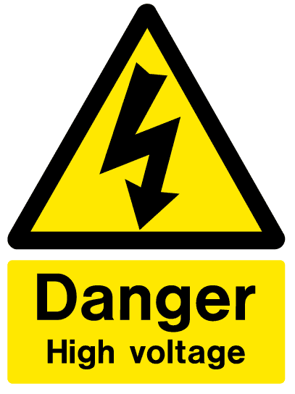
Alexander C. Frank, ETH Zürich 03.07.2010

Slide 2
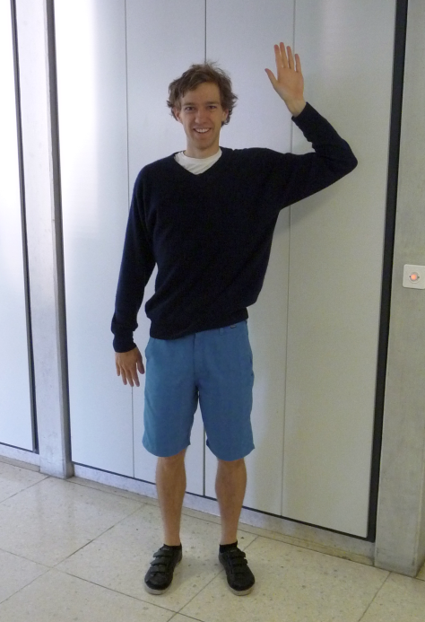
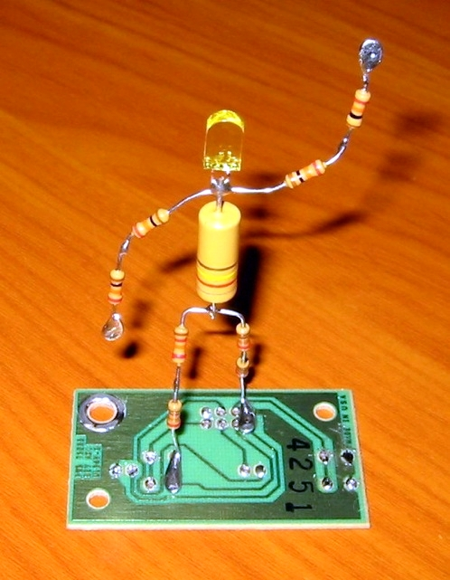
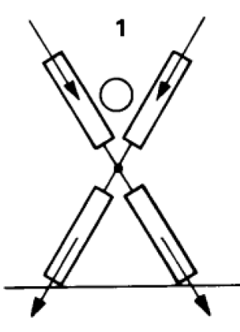
Why is High Voltage dangerous ?
Georg Simon Ohm: “Ohm‘s Law“, 1881
(No electronic accidents reported before that date ☺ )
Human Body : R = 1 kΩ
depends on body, clothing, shoes, …
Notes:
Having a look at the human body – you‘ll agree with me, that we can model it with the use of Resistors, and with the help of RESISTOR-MAN, we finally end up in a single resitstor.

Slide 3
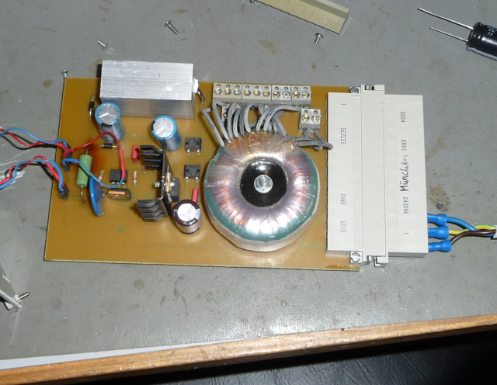
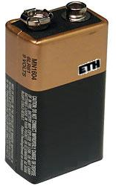
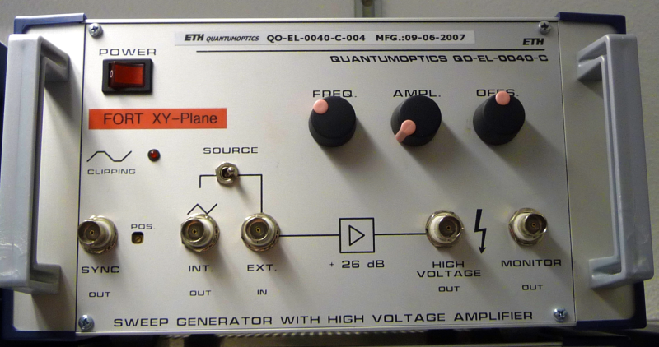
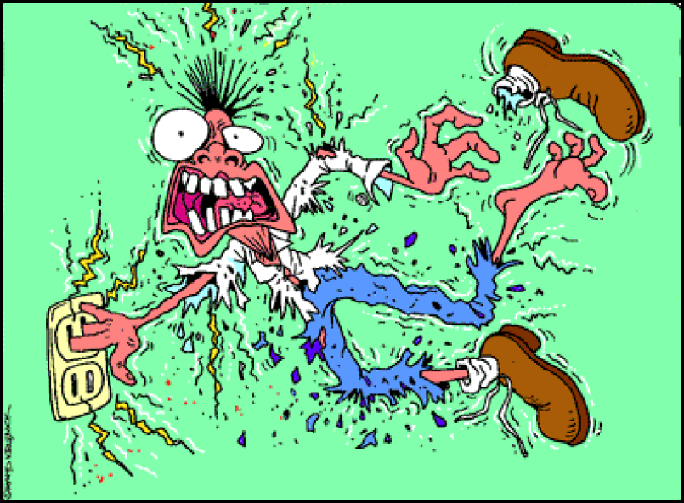
I = U / R
I ~ 9 mA
I < 20 mA
(by Design)
Notes:
Now – applying Ohm‘s Law, we get some numerical values ..

Slide 4
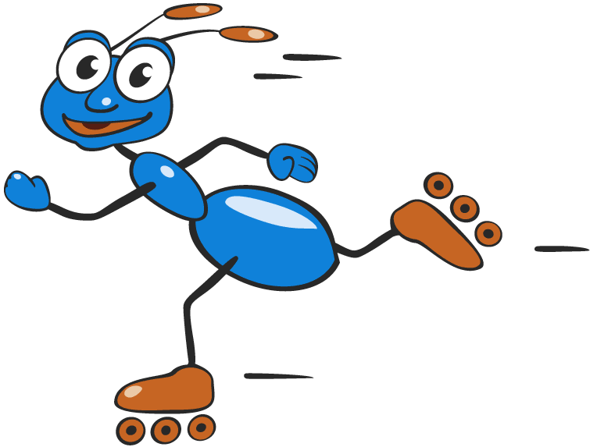
Body – Electron Interactions
(Heartbeat out of lock ☹)
0.05 mA prickle (kribbeln)
1 - 15 mA heavy prickle, start of cramp
15 - 20 mA cannot release conductor
20 - 50 mA heavy cramp, 3 – 4 Min. to death
> 50 mA cardiac fibrillation, seconds to death
when applying DC Voltage an electrolysis of the blood is to be added.

Slide 5
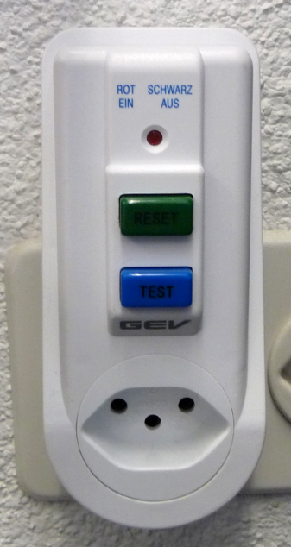
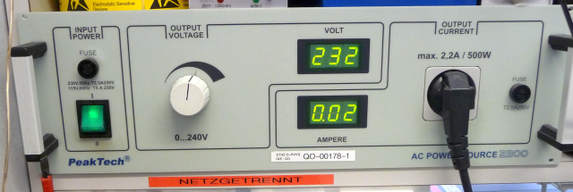
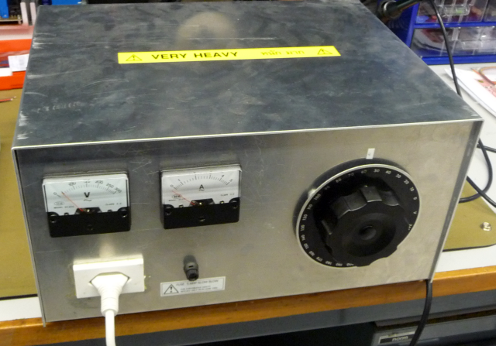
PRECAUTIONS
by command of the executive board !
NEVER ever work alone with High Voltage (> 50 V)
Use FI-Switch (Residual Current Protective Device)
OR
Use Isolation
Transformer

Slide 6
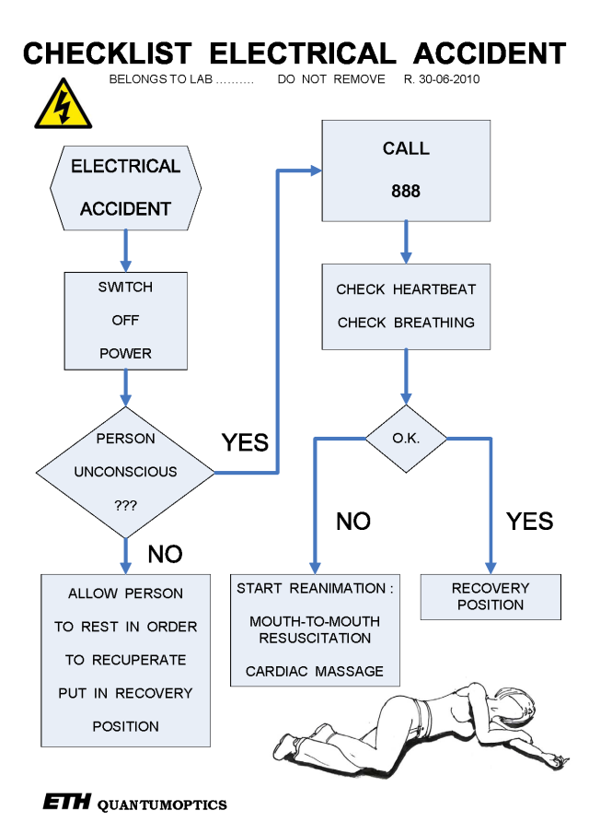
NEVER work alone with High Voltage (> 50 V)
There is nobody who can
switch off the current
perform first aid
call a doctor (MD!!!)
read the Emergency Checklist ☹

Slide 7
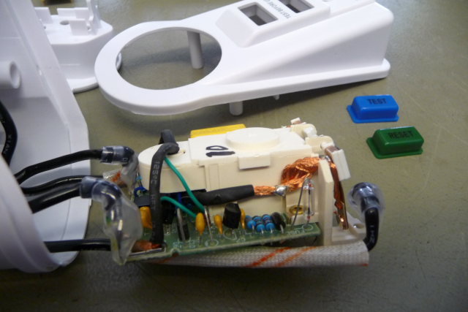
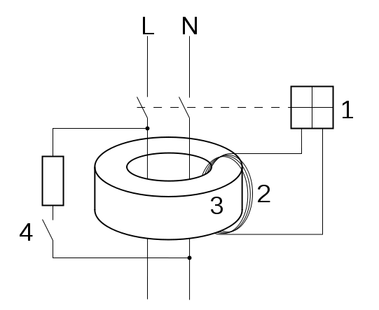
How does an FI-Switch work ?
Notes:
Normal Operation : I_N and I_L are equal >>> NO magnetic flux in toroid 3.
If current uses other path : difference in I_N and I_L >>> magnetic flux will be detected by coil 2 and a switch 1 will switch off.

Slide 8
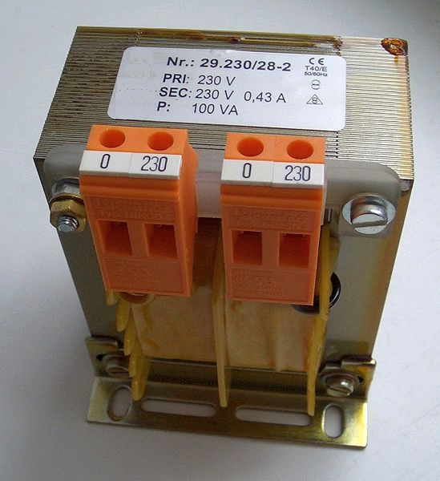
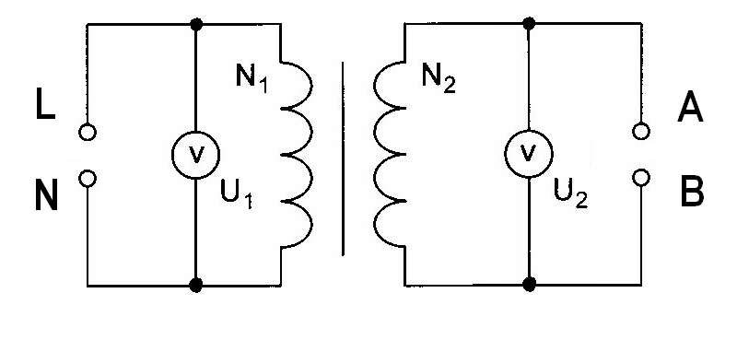
How does an Isolation Transformer work ?
Notes:
On primary side, L and N are well defined.
If user touches wire on secondary side, this one will become the N-conductor.
Do not touch both !!!!!!!

Slide 9
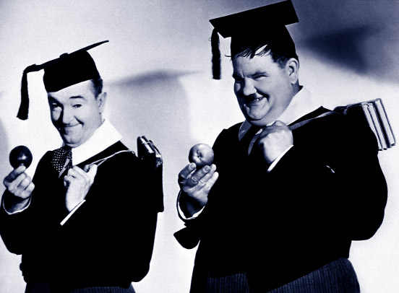
Any Questions ???
esta noche buena suerte !

Slide 10
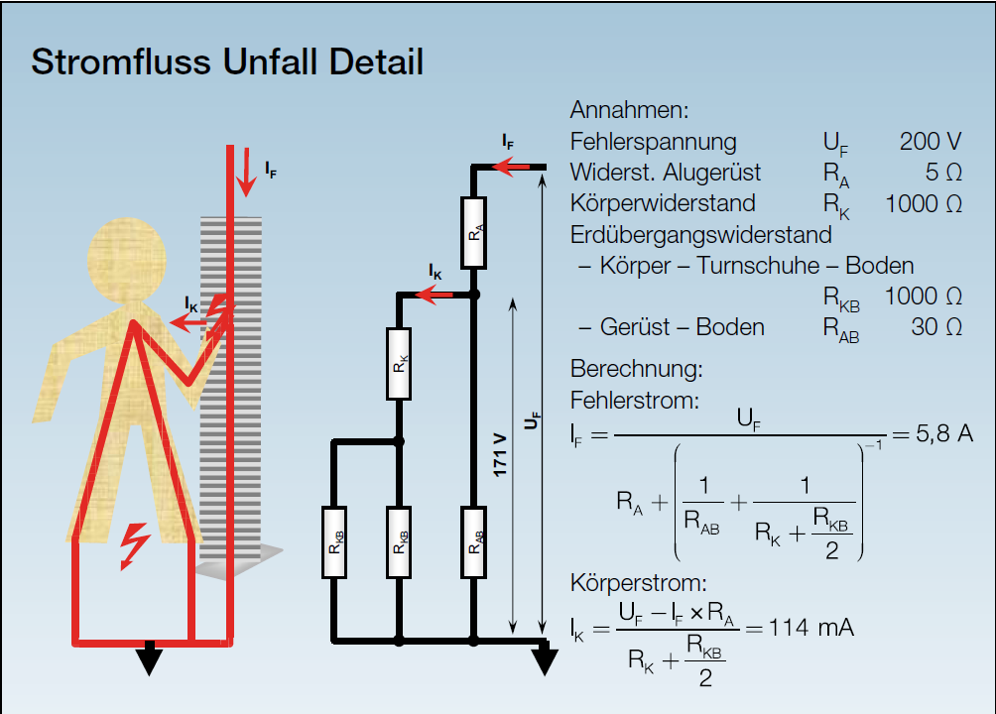
Numeric Example :

